Slide 1

DocTime

Slide 2


THE TEAM MEMBERS
Rifah Tamanna||
18201073
Mahbuba Haque Laka|| 18201085

Slide 3
UML Diagram
Schema Diagram
ER Diagram

Slide 4
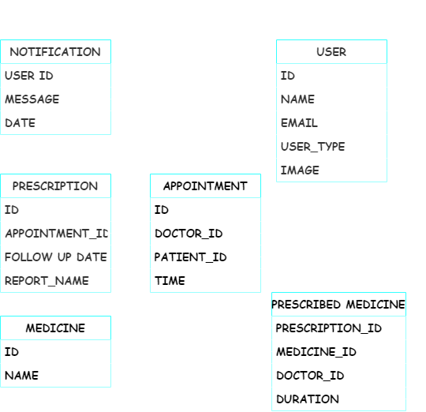

Slide 5
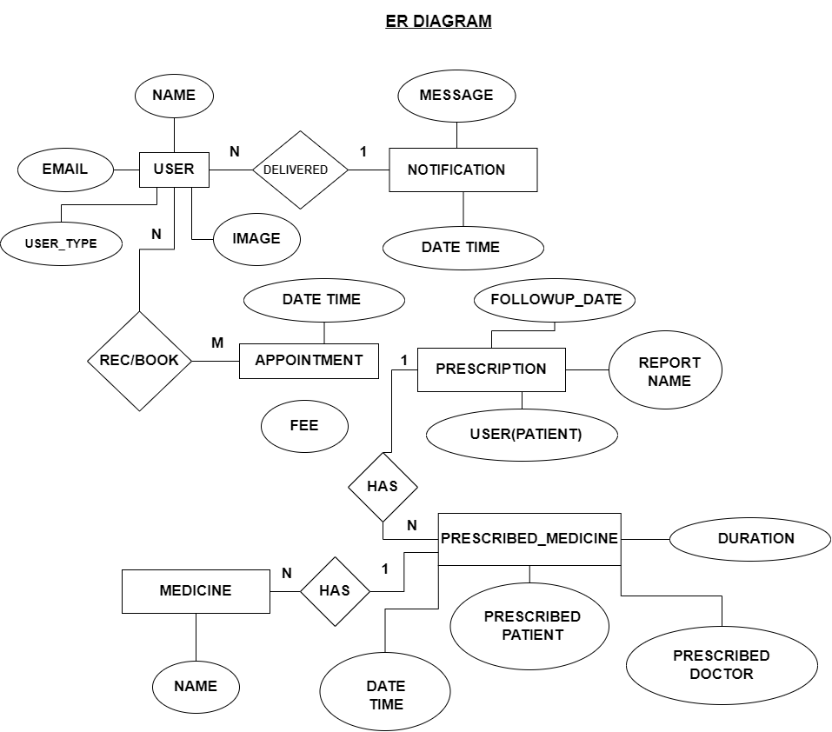

Slide 6
THANK YOU

